Slide 1
Introducing Usage Control in MQTT protocol for IoT

Slide 2
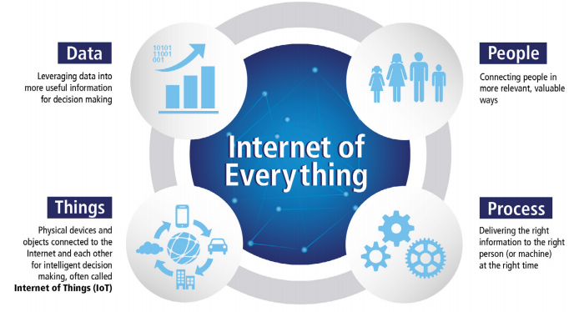
Internet of Things/Everything (IoT/IoE)
Internet of Things (IoT)
Inter-networking of Cyber-Physical devices and other items embedded with:
Electronics
Software
Sensors
Actuators
Network connectivity
Enables these objects to collect and exchange data
Internet of Everything (IoE)
Intelligent connection of
People
Process
Data
Things

Slide 3
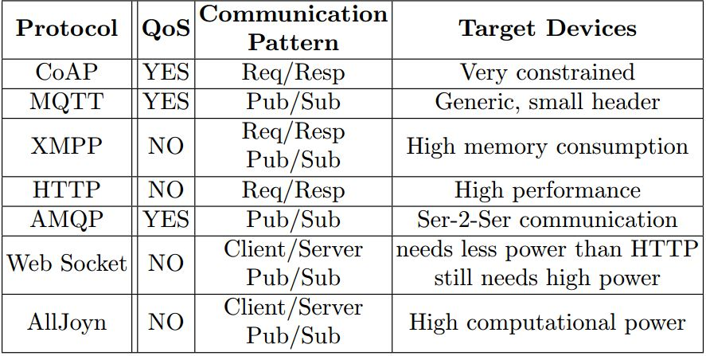
IoT Application Layer Protocols
Most popular application layer protocols used nowadays:
CoAP: Constrained Application Protocol
MQTT: Message Queuing Telemetry Transport
XMPP: Extensible Messaging and Presence Protocol
AMQP: Advanced Message Queuing Protocol
WebSocket: Computer Communications Protocol
Alljoyn: Full stack of protocols intended for IoT. Not separable application layer protocol

Slide 4

MQTT
Introduced by IBM
MQTT is one of the most commonly used protocols in IoT projects. It stands for Message Queuing Telemetry Transport.
Standardized by OASIS (2013)
Uses Publish/Subscribe mechanism controlled by Broker
Broker
Software component
Responsible for distributing messages from Publishers to interested Subscribers
MQTT versions
MQTT-SN
S-MQTT

Slide 5
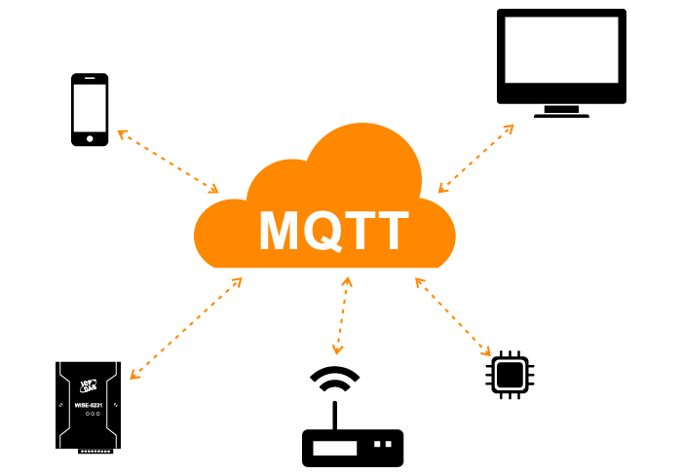
MQTT
It is designed as a lightweight messaging protocol that uses publish/subscribe operations to exchange data between clients and the server.
Furthermore, its small size, low power usage, minimized data packets and ease of implementation make the protocol ideal of the “machine-to-machine” or “Internet of Things” world.

Slide 6
Why MQTT?
MQTT has unique features you can hardly find in other protocols, like:
It’s a lightweight protocol. So, it’s easy to implement in software and fast in data transmission.
It’s based on a messaging technique. Of course, you know how fast your messenger/WhatsApp message delivery is. Likewise, the MQTT protocol.
Minimized data packets. Hence, low network usage.
Low power usage. As a result, it saves the connected device’s battery.
It’s real time! That’s is specifically what makes it perfect for IoT applications.

Slide 7
How MQTT works
Like any other internet protocol, MQTT is based on clients and a server. Likewise, the server is the guy who is responsible for handling the client’s requests of receiving or sending data between each other.
MQTT server is called a broker and the clients are simply the connected devices. So:
When a device (a client) wants to send data to the broker, we call this operation a “publish”.
When a device (a client) wants to receive data from the broker, we call this operation a “subscribe”.

Slide 8
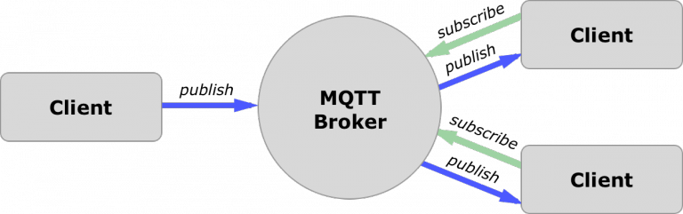
In addition, These clients are publishing and subscribing to topics. So, the broker here is the one that handles the publishing/subscribing actions to the target topics.

Slide 9
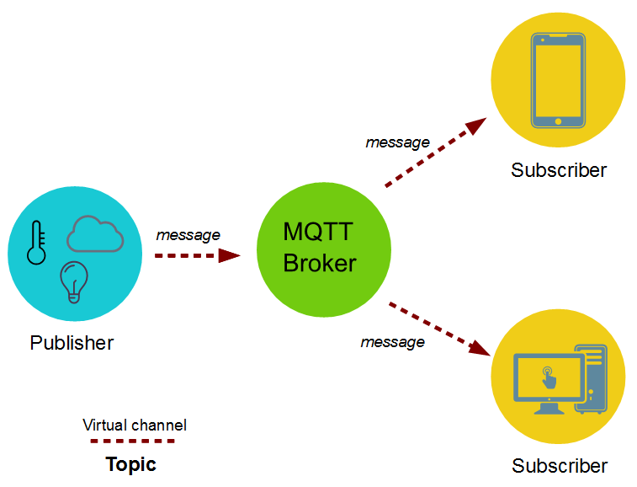
MQTT component details
Many – to – many Sub to Pub relationship
One Broker for every system
Subs authenticated to Broker
Subs/Pubs can be very constrained
Pub can be even only a sensor
Broker has to provide more computational power

Slide 10
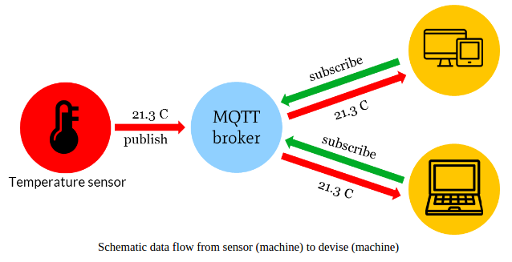
Example
Let’s say there is a device that has a temperature sensor. Certainly, it wants to send his readings to the broker. On the other side, a phone/desktop application wants to receive this temperature value. Therefore, 2 things will happen:
The device defines the topic it wants to publish on, ex: “temp”. Then, it publishes the message “temperature value”.
The phone/desktop application subscribes to the topic “temp”. Then, it receives the message that the device has published, which is the temperature value.
Again, the broker role here is to take the message “temperature value” and deliver it to phone/desktop application.

Slide 11
MQTT Components:
That takes us to the MQTT components, which are 5 as follows:
Broker, which is the server that handles the data transmission between the clients.
A topic, which is the place a device want to put or retrieve a message to/from.
The message, which is the data that a device receives “when subscribing” from a topic or send “when publishing” to a topic.
Publish, is the process a device does to send its message to the broker.
Subscribe, where a device does to retrieve a message from the broker.

Slide 12
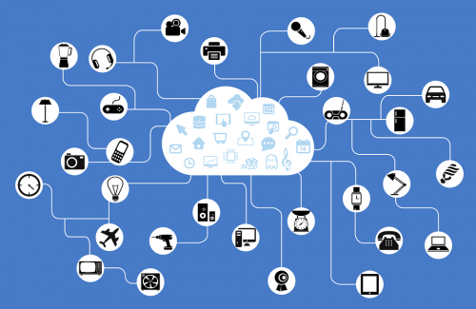
How many devices you can connect to a broker
The number of connected devices “clients” to the broker depends on the broker service provider.
In fact, it can reach a massive number of clients those are publishing and subscribing all the time.
but the amazing part of this isn’t only the huge number of these connected devices but also any the fact that any device can get any other device’s data at any time. As a result, the applications based on these quickly shared data are limitless.

Slide 13
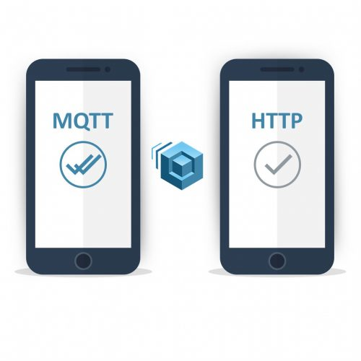
Why not HTTP
HTTP is slower, more overhead and power consuming protocol than MQTT. So, let’s get into each one separately:
Slower: because it uses bigger data packets to communicate with the server.
Overhead: HTTP request opens and closes the connection at each request, while MQTT stays online to make the channel always open between the broker “server” and clients.
Power consuming: since it takes a longer time and more data packets, therefore it uses much power.

Slide 14
Mosquitto broker
Mosquitto is an open source message broker that implements the MQTT protocol. It’s lightweight and suitable for use on all devices from a low power single board like Arduino, ESP8266 to full computers and servers.
But rather than using the Mosquitto on a local PC, you will need to use a cloud-based server that implements the Mosquitto broker. That’s necessary to make your IoT projects controllable over the internet.
Cloud-based Mosquitto brokers are many, like:
ThingMQ
ThingStudio
MQTT.io
Heroku
CloudMQTT

Slide 15
reference
https://1sheeld.com/mqtt-protocol/?__cf_chl_jschl_tk__=3fe5d458d05c1379f48380d7a8765e15f9db44c1-1582548302-0-AftAWOKKV61CHqC4A_SMpD_Q17FpY6T81nQmgQjV0xMRTG39nvgERSxMPAD80HCC2mgEbC0_oFQzxzvmCD7ZRTeawfKjyX3i0YdtyqZ9VXCn4KLnddfI-Dm8dZg71MqESx-hTrAut-p2bGkwIjZiU4URsrtR6ibFJ0yeOrYThMoKnblS2xW6smu4vlDGvNH0DcH3THAjkwSbGb2rZp4r8QzOhy2uh1Y00YOMBp8aRYMj8sGg2hz5_SyEXjJtgXvswTcz4fbuSt0WE4ypaLscNLMGRNwvyFgQ2PdP3S8qkkL6

Slide 16
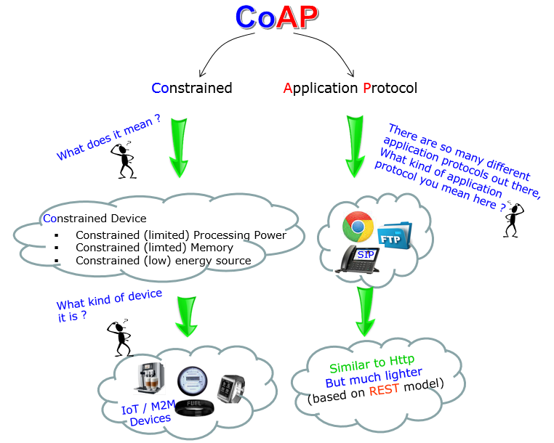
What Is CoAP Protocol?
As said before, CoAP is an IoT protocol. CoAP stands for Constrained Application Protocol, and it is defined in RFC 7252.
CoAP is a simple protocol with low overhead specifically designed for constrained devices (such as microcontrollers) and constrained networks.
This protocol is used in M2M data exchange and is very similar to HTTP.
The main features of CoAP protocols are:
• Web protocol used in M2M with constrained requirements
• Asynchronous message exchange
• Low overhead and very simple to parse
• URI and content-type support
• Proxy and caching capabilities

Slide 17
As you may notice, some features are very similar to HTTP even if CoAP must not be considered a compressed HTTP protocol because CoAP is specifically designed for IoT and in more details for M2M so it is very optimized for this task.
It is a simplification of the HTTP protocol running on UDP, that helps save bandwidth. It is designed for use between devices on the same constrained network (e.g., low-power, lossy networks), between devices and general nodes on the Internet, and between devices on different constrained networks both joined by an internet.
CoAP is also being used via other mechanisms, such as SMS on mobile communication networks.

Slide 18
When to use
Some of the specific cases in which CoAP are useful are:
Your hardware cannot run HTTP or TLS: If this is the case then running CoAP and DTLS can practically do the same as HTTP. If one is an expert on HTTP APIs, then the migration will be simple. You receive GET for reading and POST, PUT and DELETE for mutations and the security runs on DTLS.
Your hardware uses battery: If this is ones problem then running CoAP will improve the battery performance when compared with HTTP over TCP/IP. UDP saves some bandwidth and makes the protocol more efficient.
A subscription is necessary: If one cannot run MQTT and HTTP polling is impossible then CoAP is a solution

Slide 19
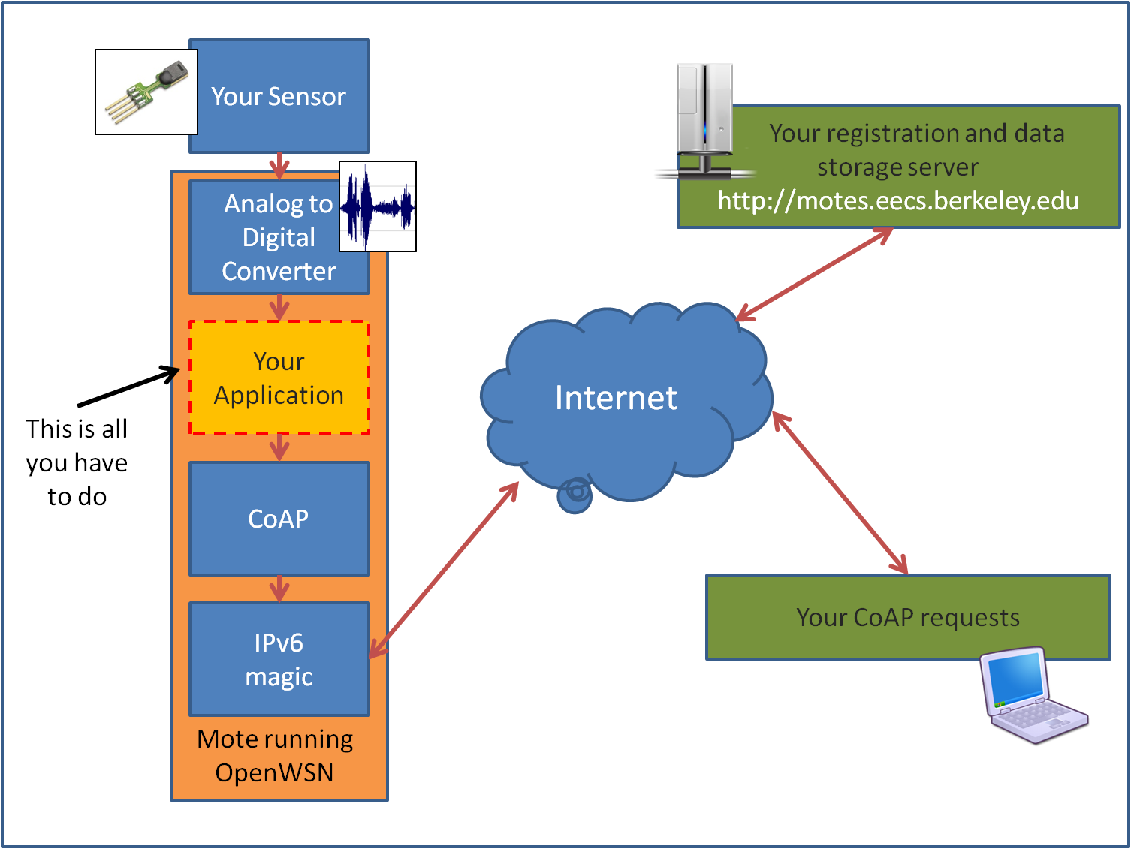

Slide 20
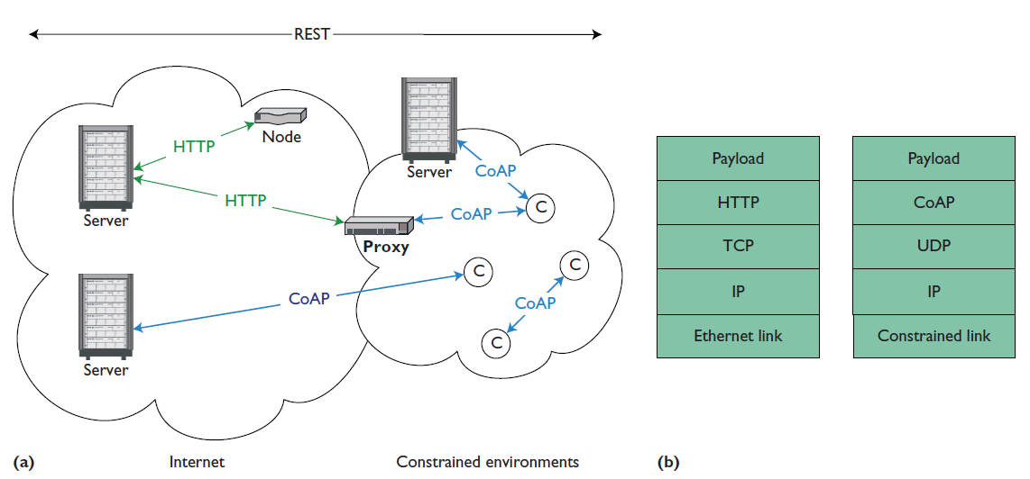

Slide 21
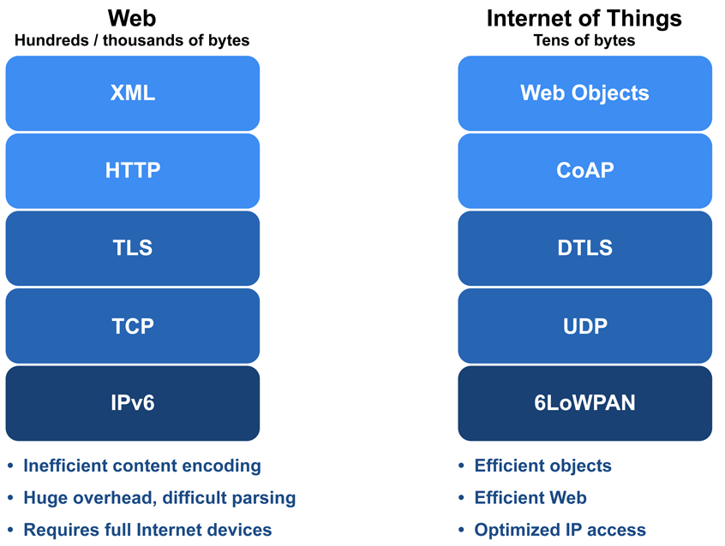
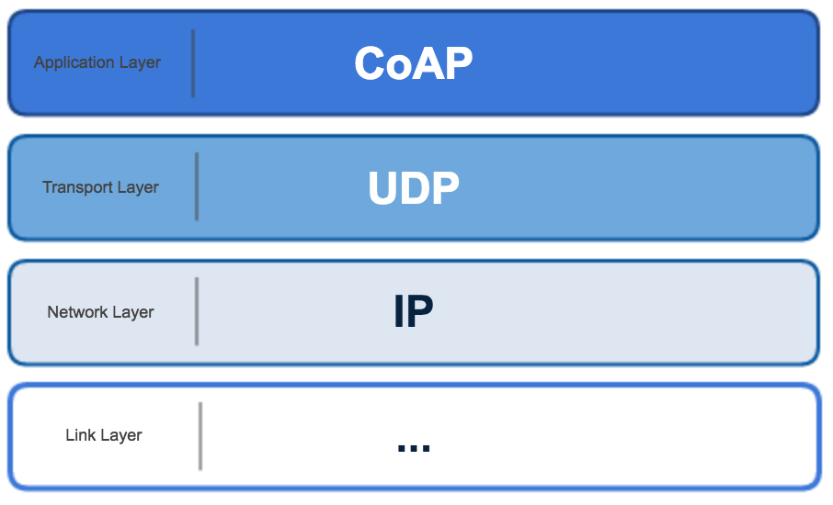

Slide 22
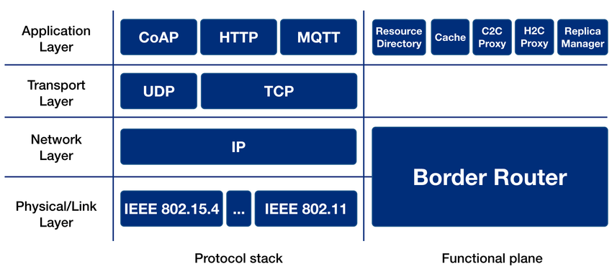

Slide 23
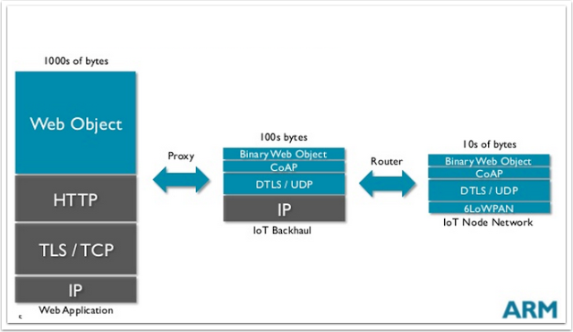
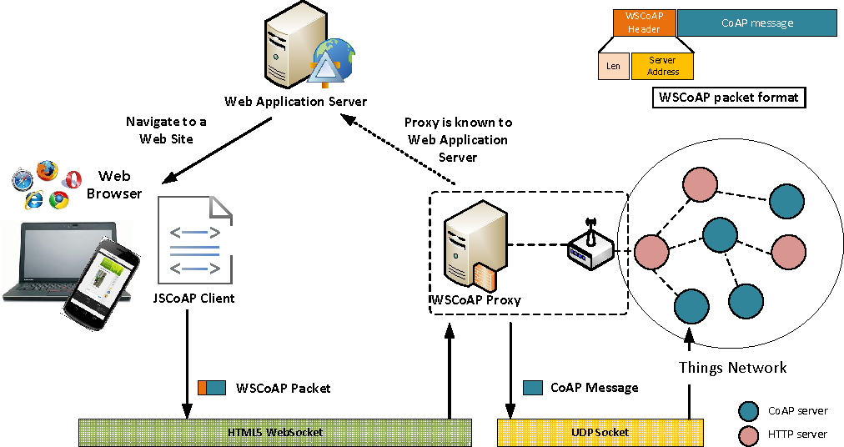

Slide 24
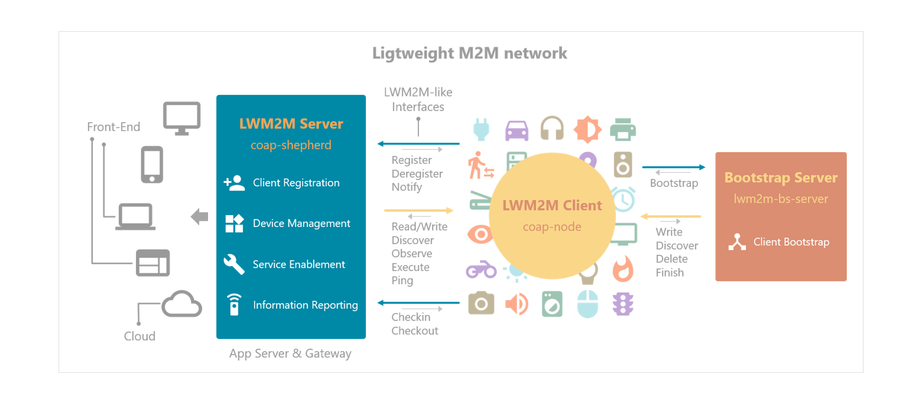

Slide 25
Both MQTT and CoAP:
Are open standards
Are better suited to constrained environments than HTTP
Provide mechanisms for asynchronous communication
Run on IP
Have a range of implementations

Slide 26
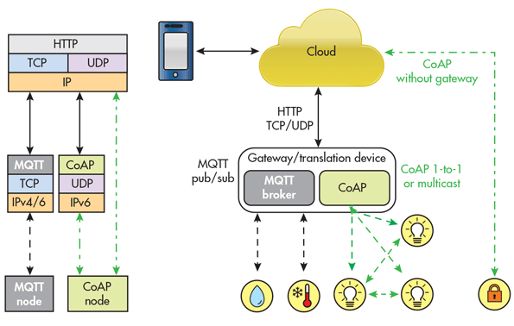
MQTT and CoAP in Action

Slide 27
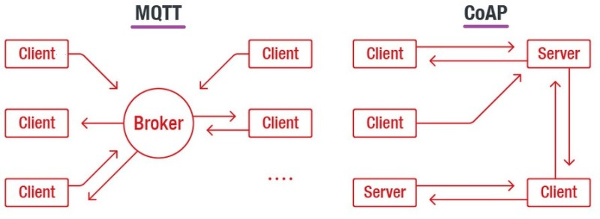

Slide 28
Features | CoAP | MQTT
Full Form | Constrained Application Protocol | Message Queue Telemetry Transport
Model used for communication | Request-Response, Publish-Subscribe | Publish-Subscribe
RESTful | Yes | No
Transport layer | Preferably UDP, TCP can also be used. | Preferably TCP, UDP can also be used (MQTT-S).
Header Size | 4 Bytes | 2 Bytes
Number of message types used | 4 | 16
Messaging | Asynchronous & Synchronous | Asynchronous
Application Reliability | 2 Levels | 3 Levels
Security | IPSEC or DTLS | Not defined in the standard
Intermediaries | YES | YES (MQTT-S)
LLN Suitability (thousand nodes) | Excellent | Fair
Application success stories | Utility Field Area Networks | Extending enterprise messaging into IoT applications

Slide 29
Comparison
MQTT and CoAP are both useful as IoT protocols, but have fundamental differences.
MQTT is a many-to-many communication protocol for passing messages between multiple clients through a central broker. It decouples producer and consumer by letting clients publish and having the broker decide where to route and copy messages. While MQTT has some support for persistence, it does best as a communications bus for live data.
CoAP is, primarily, a one-to-one protocol for transferring state information between client and server. While it has support for observing resources, CoAP is best suited to a state transfer model, not purely event based.

Slide 30
MQTT clients make a long-lived outgoing TCP connection to a broker. This usually presents no problem for devices behind NAT. CoAP clients and servers both send and receive UDP packets. In NAT environments, tunnelling or port forwarding can be used to allow CoAP, or devices may first initiate a connection to the head-end as in LWM2M.
MQTT provides no support for labelling messages with types or other metadata to help clients understand it. MQTT messages can be used for any purpose, but all clients must know the message formats up-front to allow communication. CoAP, conversely, provides inbuilt support for content negotiation and discovery allowing devices to probe each other to find ways of exchanging data.
Both protocols have pros and cons, choosing the right one depends on your application.

Slide 31


